Slide 1
CPE 656
Software Engineering Studio I
Train Location Project
University of Alabama in Huntsville
November 09, 2015
Stephen Jalbert
Rashad Madyun
Corey Sanders

Slide 2
WORK PRODUCTS
Status
SDS: Added Overview and Terms
Geometry Collection: Finished Triangulation Script, Created Alternate Process for Data Collection
SDP: Reorganized format
CMP: Added Descriptions for Source Changes, Added Figures
SRS: Reformatted Requirements. Updated Text
STP: Updated Traceability Matrix. Updated Text.

Slide 3
WORK PRODUCTS
Agenda (10/26 – 11/2)
ROM, SDP , CMP,
  Update Documents From Feedback
Test Plan
  Await Feedback
SRS
  Add Activity Diagrams
SDD
  Update based on Team Review Feedback
Geometry Collection
  Collect Datasets

Slide 4
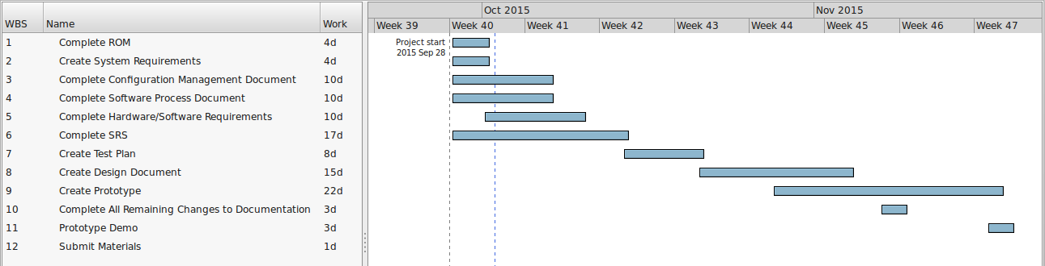
Schedule

Slide 5
Schedule (pt 2)
Work Product | Date Drafted Expected | Date Draft Completed
ROM | 10/1 | 10/1
SRS | 10/14 | 10/19 | Delayed by waiting on trying to get feedback on high level features
CM | 10/7 | 10/7
SDP | 10/7 | 10/7
STP | 10/21 | 10/23
SDS | 11/4 | ETA: 11/18 | Additional delay from work made for prototyping and corrections to other documents.
Prototype | 11/18 | TBD | Working on Hardware, Working on UI Mockup, Working on Geometry Points

